Slide 1
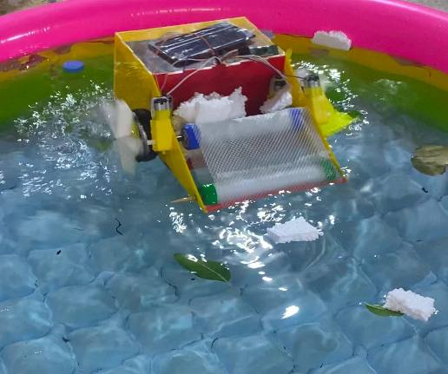

Project Name: Ecopurify
Team Name: Sama Taha
Group: Seniors
Theme: Life below water and
life on land

Slide 2


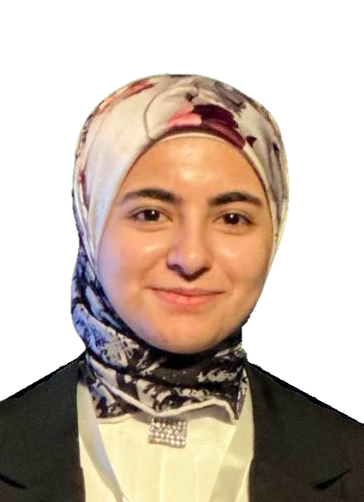
Codeavour 6.0 International
Team Member
• Sama Taha, ms Ola

Slide 3
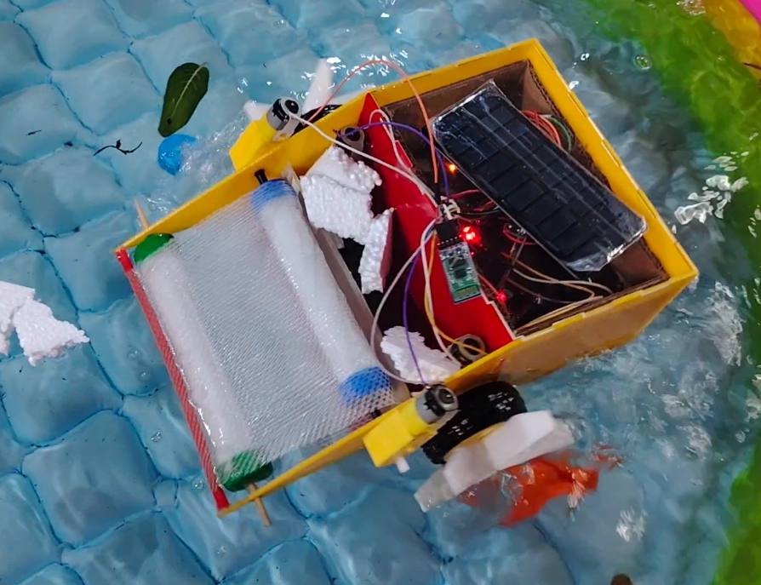
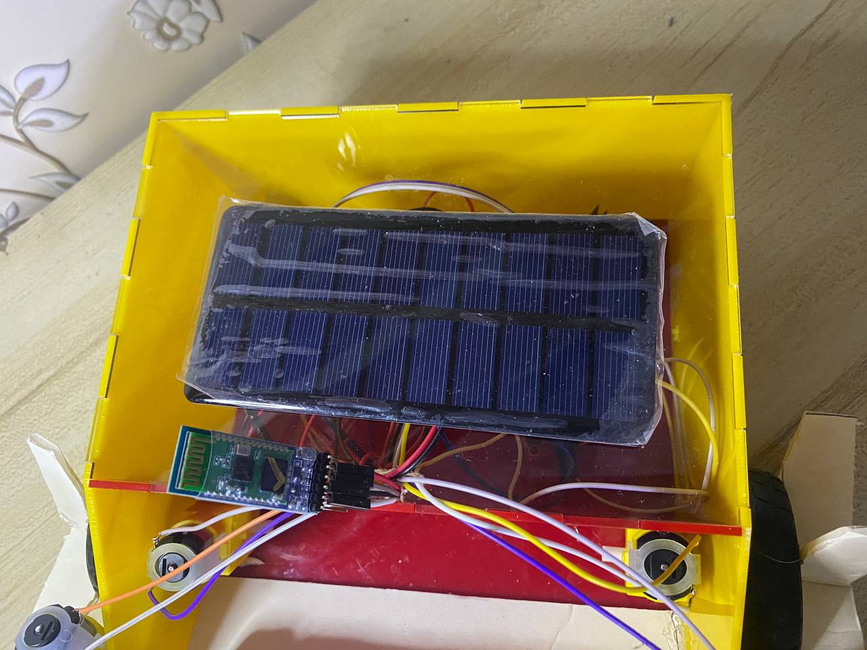
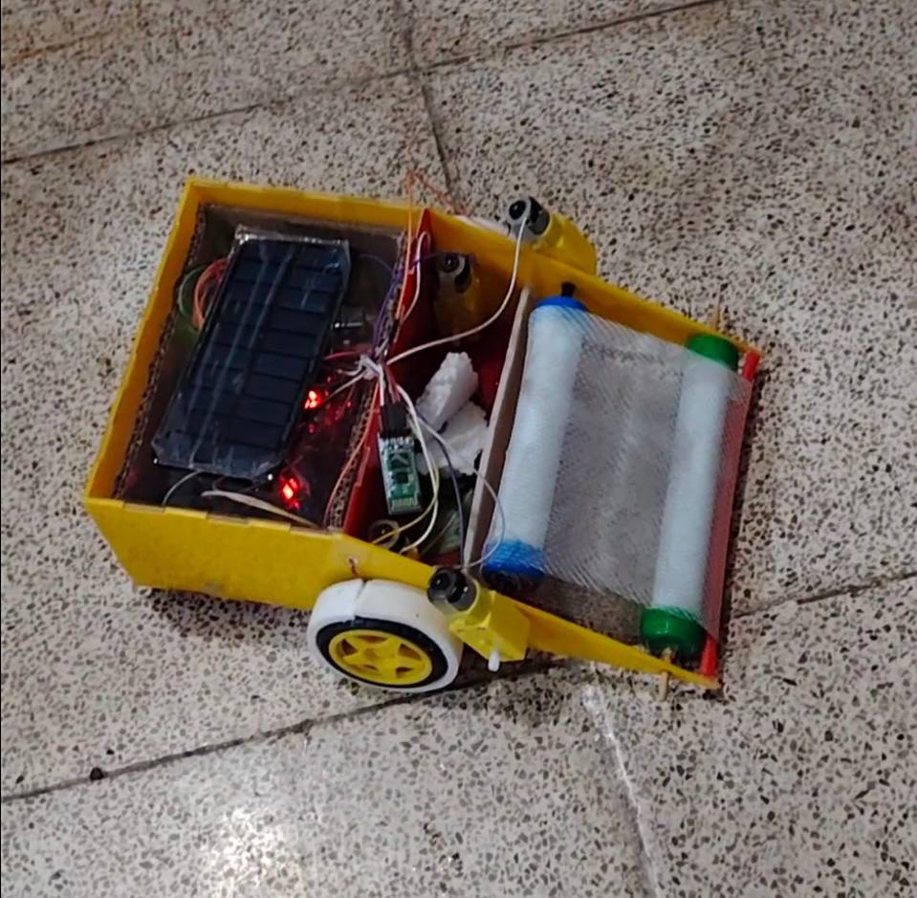
Life below water and life on land
Ecopurify
• a description: device that cleans waste on land and in water to maintain a clean environment and relies on clean energy (solar energy) by remote control
• video link: https://youtu.be/HiKegzxdnmg?si=gt0betEPWsSXFG7R
• hardware used: Arduino uno, motor driver, 4 dc motors, solar panel, 2 lithium batteries
Add Image

Slide 4

Problem
The design of this project using technology is a solution to many problems caused by waste to the environment, such as soil pollution and its impact on animals, water pollution, harm to marine life, air pollution, and the emission of toxic gases. Most importantly, climate change.

Slide 5

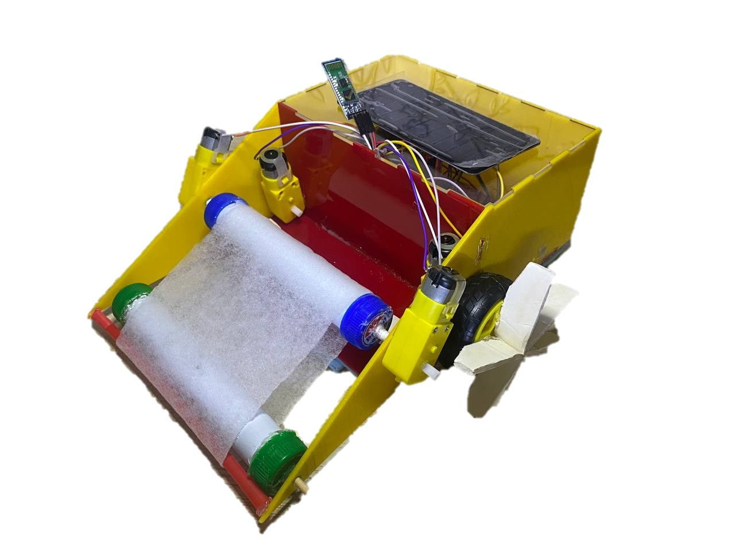
Solution
• solution: . Through this project, technology, Arduino, C++ in pictoblox and clean solar energy will be used to clean this waste with less effort and time. Compared to large traditional machines used to clean waste its an ideal choice for widespread use. It can be used in the wild and aquatic environments . It will maintain the cleanliness of the environment and the damage that this waste can cause.

Slide 6
My
Solution
Existing Solutions
• Available solutions include voluntary clean-up campaigns and preventive solutions such as environmental awareness.
• My project provides a solution by using technology in addition to clean energy to clean waste in less time and without the need for human intervention.

Slide 7
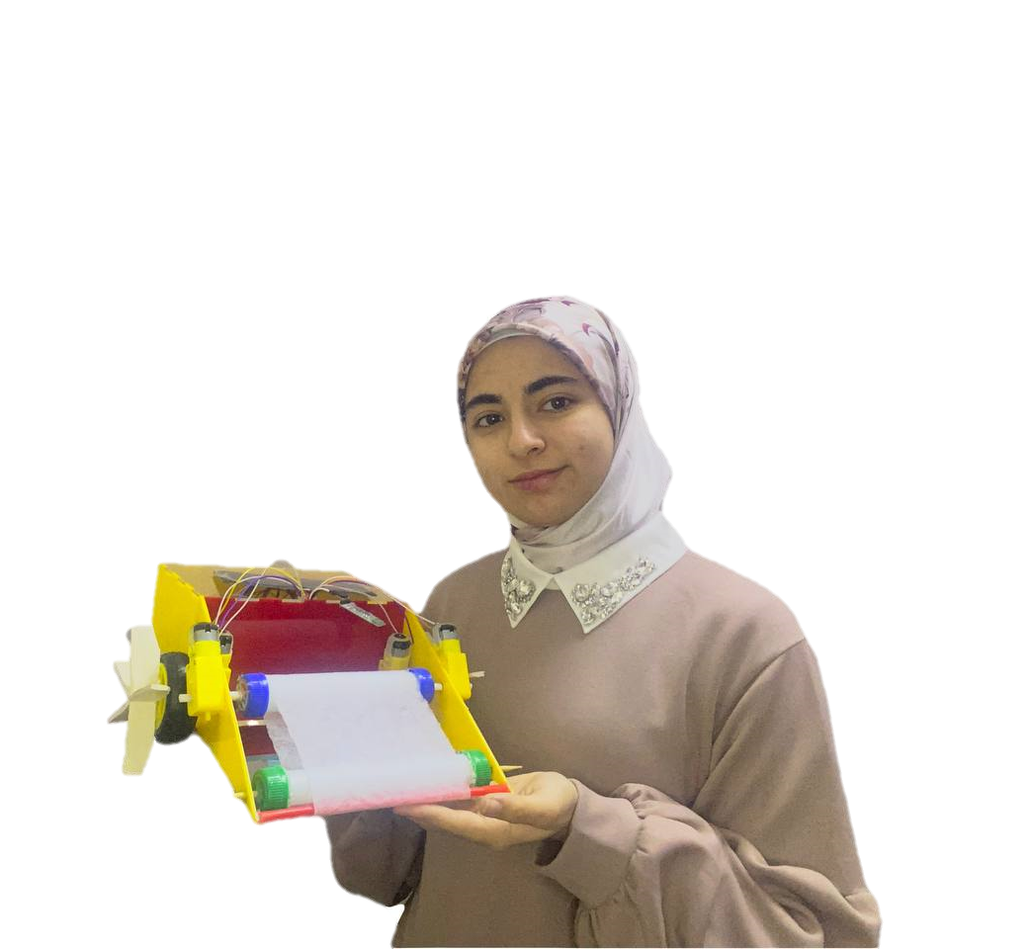

I AM A YOUNG INNOVATOR
THANK YOU!
www.codeavour.org

